Slide 1
IPO Advisory Firm
Clare Specht
Eduardo Barreto
Tracey Fudge
Naomi Gebru
Notes:
SPEAKER: Tracey
Notes: why we chose IPO Advisory, because this topic is pertinent and relevant to Eduardo's role.

Slide 2
Who we are…
As a Private Equity Advisory Firm our charter is to consult our clients on both
ideal target industries as well as advise on the valuation therein.
We analyzed 3 years' worth of data…..2019, 2020 and 2021.
Notes:
Speaker: Tracey

Slide 3
Our mission
We were tasked with understanding the trends of companies that
went public in the last 3 years:
Who they are?
What do they do?
What is their size?
Where are they?
This information will be leveraged in order to make decisions as to what companies to acquire
Notes:
Speaker: Tracey
Notes:

Slide 4

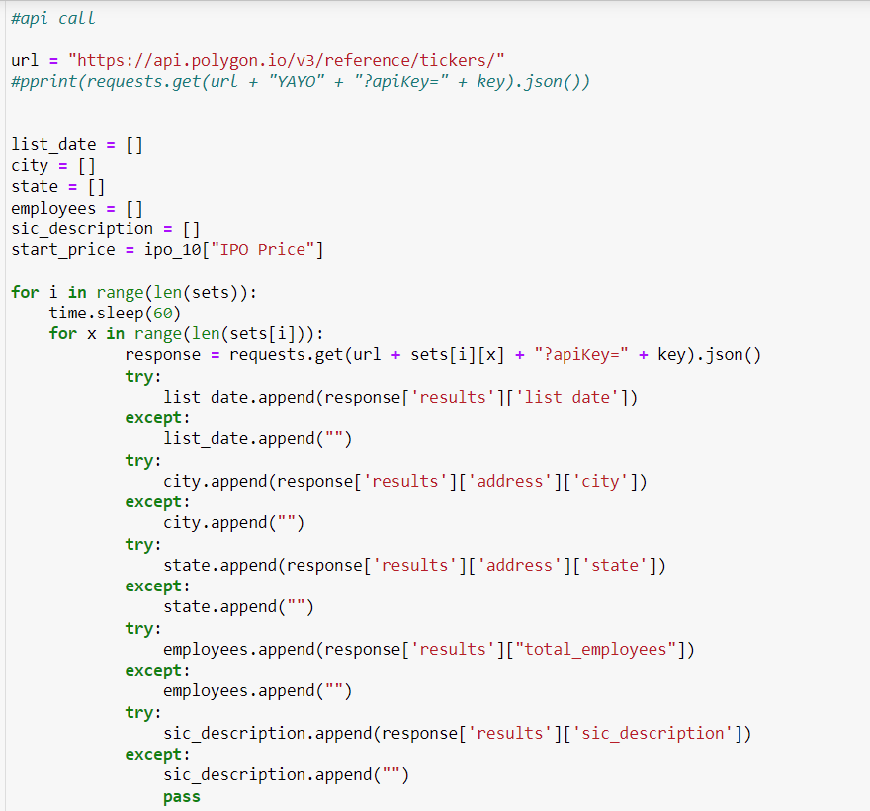

OUR DATA SOURCES
Provided us with a least of the companies that went public, their IPO, their symbol, and the listed Date
We leveraged two different data bases to collect info
Provided an extensive data frame, with more information for each company; leveraged through an API
Notes:
Speaker: Clare
Notes:

Slide 5

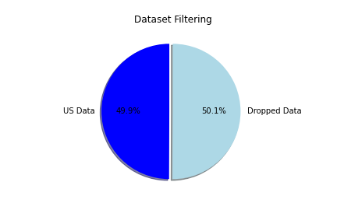
Data limitations
Due to cost we couldn’t paid for full API services and the one we could afford had sever time limitations for API calls so we could only collect so much info
Budget
Initially collected 1746 IPOS launched
After API calls, only 935 had all the data we needed (remaining dropped)
We then dropped some IPO’s located outside the US
(872 remained)
Notes:
Speaker: Clare
Notes:

Slide 6
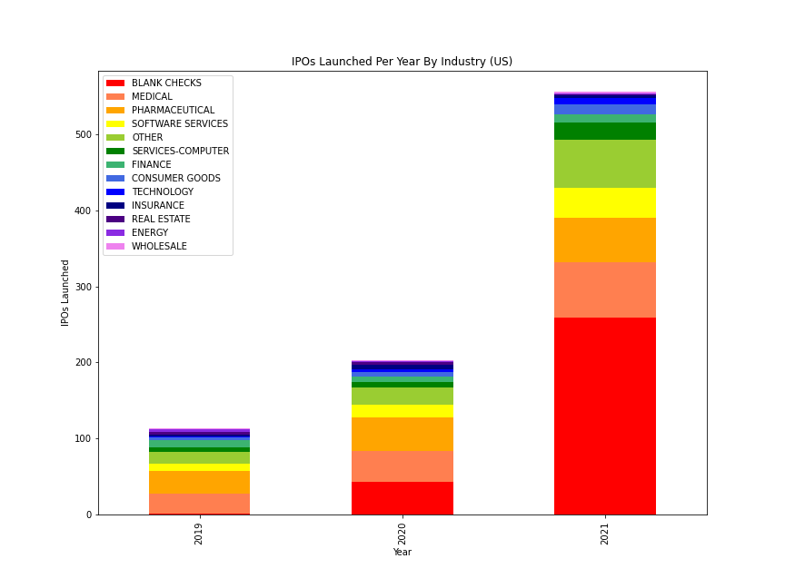
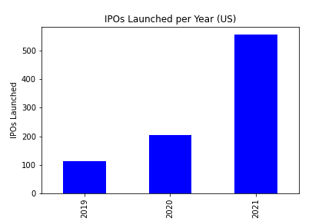
Yearly analysis
Notes:
Speaker: Naomi
Notes: Blank Checks and Other (not similar to others need to be explained

Slide 7
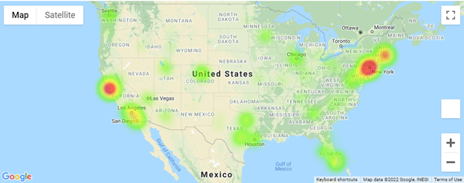
Geographic distribution
Notes:
Speaker: Naomi

Slide 8
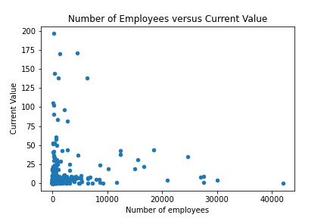
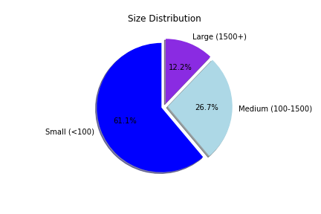
Stock price + employee size ANALYSIS
Notes:
Speaker: Eduardo
Notes: Most are under 100 ee's. No correlation b/t stock price and # employees

Slide 9
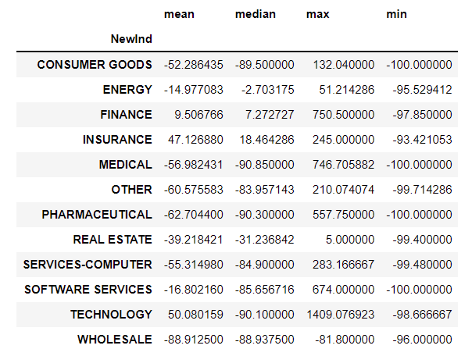
conclusion
Most IPOs were in 2021.
Company size was < 100 ee’s.
Concentrated in NY and CA.
We recommend purchasing an INSURANCE company.
Notes:
Speaker: Eduardo

